Slide 1
Power System Design
Unit-2
Load flow Analysis

Slide 2
Topic covered as:
Load flow problem
Ybus
Solution technique using Gauss seidel method

Slide 3
Introduction of Load flow study
It is also known as power flow study.
Load flow study in power system is the steady state solution of the power system network.
It is a steady –state analysis whose target is to determine the following
Bus voltage
Branch current
Real and reactive power flows in a system under a given load conditions

Slide 4
Load flow study is done on a power system to ensure that:
Generation supplies the demand (load) plus losses.
Bus voltage magnitudes remains close to rated values.
Generation operates within specified real and reactive power limits
Transmissions lines and transformers are not overloaded.

Slide 5
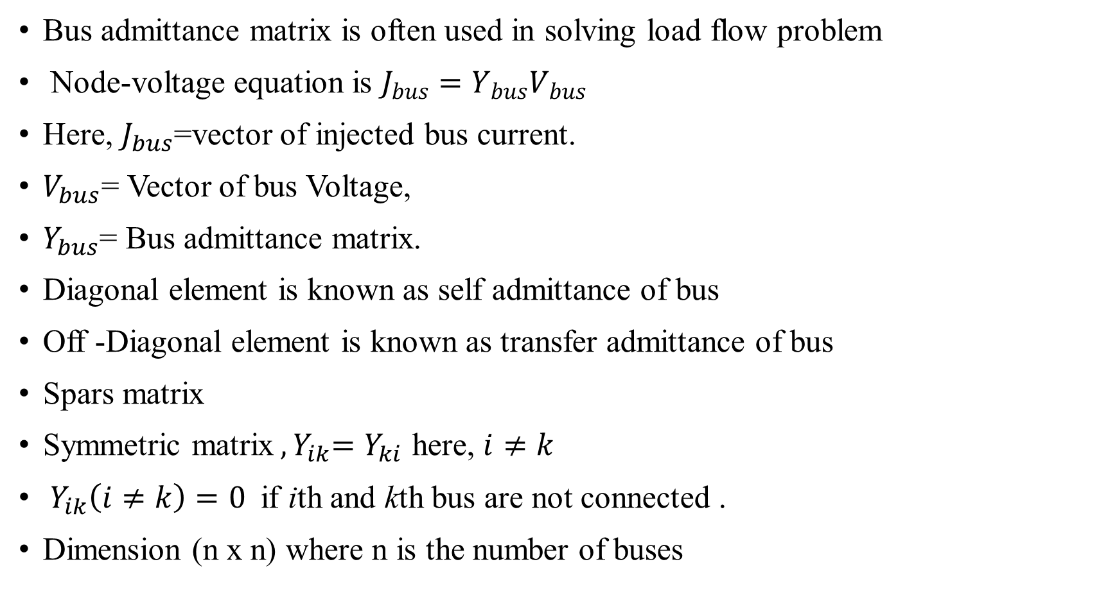
$Y_{bus}($ Bus admittance matrix).
Bus admittance matrix is often used in solving load flow problem
Node-voltage equation is $J_{bus}=Y_{bus}V_{bus}$
Here, $J_{bus}$=vector of injected bus current.
$V_{bus}$= Vector of bus Voltage,
$Y_{bus}$= Bus admittance matrix.
Diagonal element is known as self admittance of bus
Off -Diagonal element is known as transfer admittance of bus
Spars matrix
Symmetric matrix${ ,Y}_{ik}=Y_{ki}$ here, $i≠k$
${ Y}_{ik}\left(i≠k\right)=0$if ith and kth bus are not connected .
Dimension (n x n) where n is the number of buses

Slide 6
4 bus system

Slide 7
Equivalent ckt. of 4 bus system

Slide 8
Applying KCL in 4 bus system and arrange equation in matrix form

Slide 10
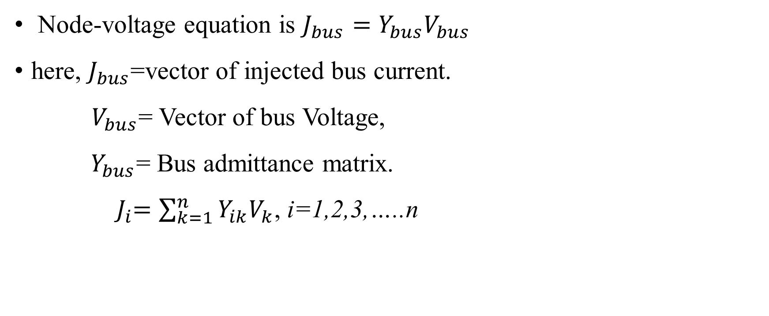
Node-voltage equation is $J_{bus}=Y_{bus}V_{bus}$
here, $J_{bus}$=vector of injected bus current.
$V_{bus}$= Vector of bus Voltage,
$Y_{bus}$= Bus admittance matrix.
${ J}_{i}=\sum_{k=1}^{n}{Y_{ik}V_{k}}$, i=1,2,3,…..n

Slide 11
Types of bus in load flow problem
There are three types of bus:
Slack bus /swing bus/Reference bus
PV bus/voltage controlled bus
PQ bus
Bus type | No. of bus | Quantities specified | Quantities unknown
Slack bus 1 | 1 | $$\left|V\right|δ$$ | 0
PV bus 2,3,---m | m-1 | P,$\left|V\right|$ | $$δ$$
PQ bus m+1,…..n | n-m | P,Q | $$\left|V\right| and δ$$

Slide 12
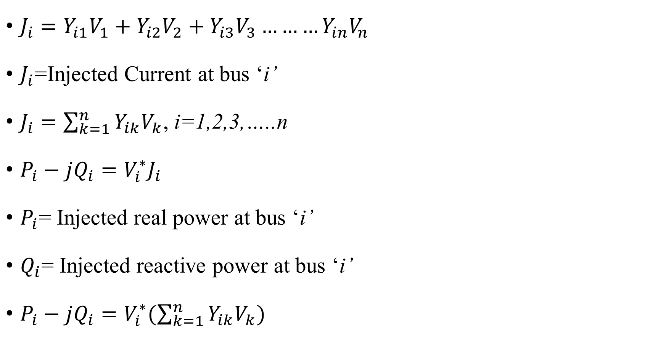
Power flow problem
$J_{i}=Y_{i1}V_{1}+Y_{i2}V_{2}+Y_{i3}V_{3}………Y_{in}V_{n}$
$J_{i}$=Injected Current at bus ‘i’
$J_{i}=\sum_{k=1}^{n}{Y_{ik}V_{k}}$, i=1,2,3,…..n
$P_{i}−jQ_{i}=V_{i}^{∗}J_{i}$
$P_{i}$= Injected real power at bus ‘i’
$Q_{i}$= Injected reactive power at bus ‘i’
$P_{i}−jQ_{i}=V_{i}^{∗}(\sum_{k=1}^{n}{Y_{ik}V_{k}})$

Slide 13

$P_{i}=re[V_{i}^{∗}\left(\sum_{k=1}^{n}{Y_{ik}V_{k}}\right)]$
$Q_{i}=−imag[V_{i}^{∗}\left(\sum_{k=1}^{n}{Y_{ik}V_{k}}\right)]$
$\sum_{k=1}^{n}{Y_{ik}V_{k}}=\frac{P_{i}−jQ_{i}}{V_{i}^{∗}}$
$Y_{ii}V_{i}+\sum_{k=1}^{i−1}{Y_{ik}V_{k}}+\sum_{k=i+1}^{n}{Y_{ik}V_{k}}=\frac{P_{i}−jQ_{i}}{V_{i}^{∗}}$
$V_{i}=\frac{1}{Y_{ii}}[(\frac{P_{i}−jQ_{i}}{V_{i}^{∗}})−\sum_{k=1}^{i−1}{Y_{ik}V_{k}}−\sum_{k=i+1}^{n}{Y_{ik}V_{k}]}$

Slide 14
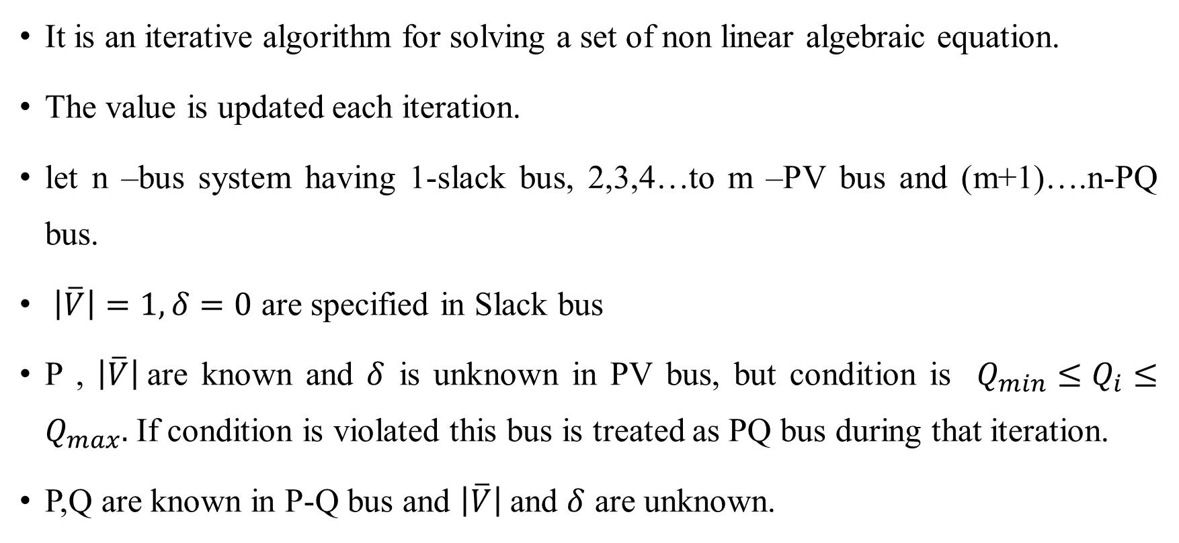
Gauss-seidel method for load flow
It is an iterative algorithm for solving a set of non linear algebraic equation.
The value is updated each iteration.
let n –bus system having 1-slack bus, 2,3,4…to m –PV bus and (m+1)….n-PQ bus.
$\left|\overline{V}\right|=1,δ=0$ are specified in Slack bus
P , $\left|\overline{V}\right|$are known and $δ$ is unknown in PV bus, but condition is $Q_{min}≤Q_{i}≤Q_{max}.$ If condition is violated this bus is treated as PQ bus during that iteration.
P,Q are known in P-Q bus and $\left|\overline{V}\right|$and $δ$ are unknown.

Slide 15
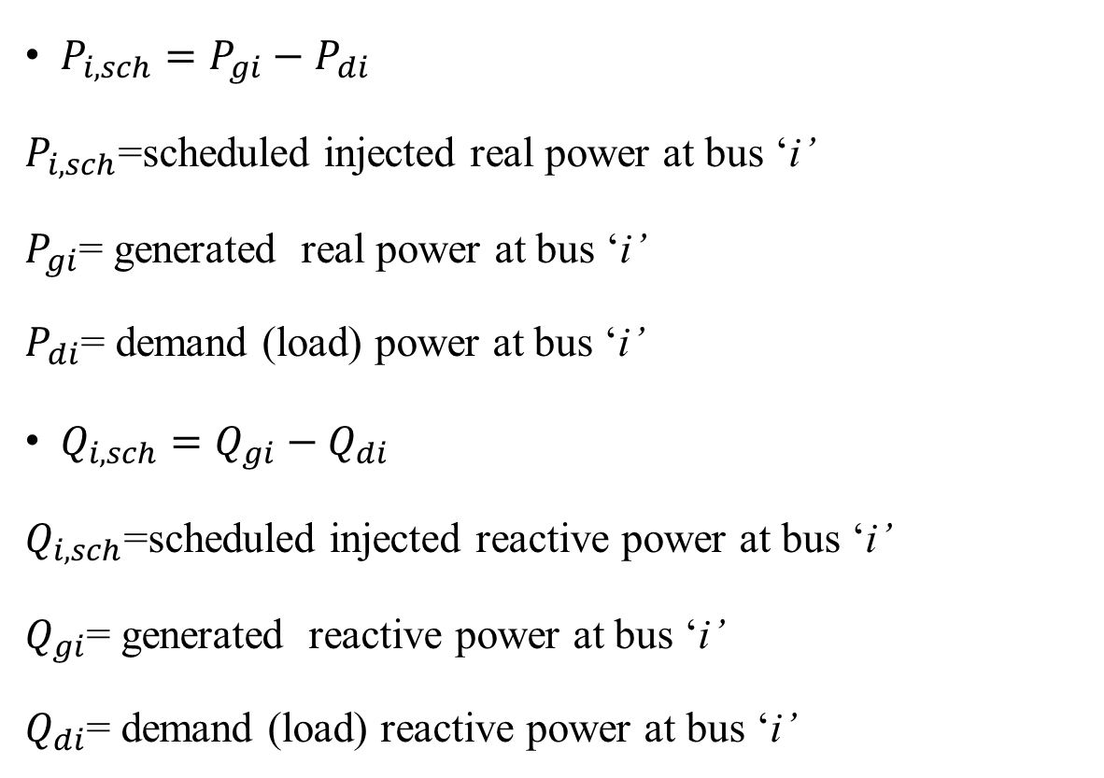
$P_{i,sch}=P_{gi}−P_{di}$
$P_{i,sch}$=scheduled injected real power at bus ‘i’
$P_{gi}$= generated real power at bus ‘i’
$P_{di}$= demand (load) power at bus ‘i’
$Q_{i,sch}=Q_{gi}−Q_{di}$
$Q_{i,sch}$=scheduled injected reactive power at bus ‘i’
$Q_{gi}$= generated reactive power at bus ‘i’
$Q_{di}$= demand (load) reactive power at bus ‘i’

Slide 16
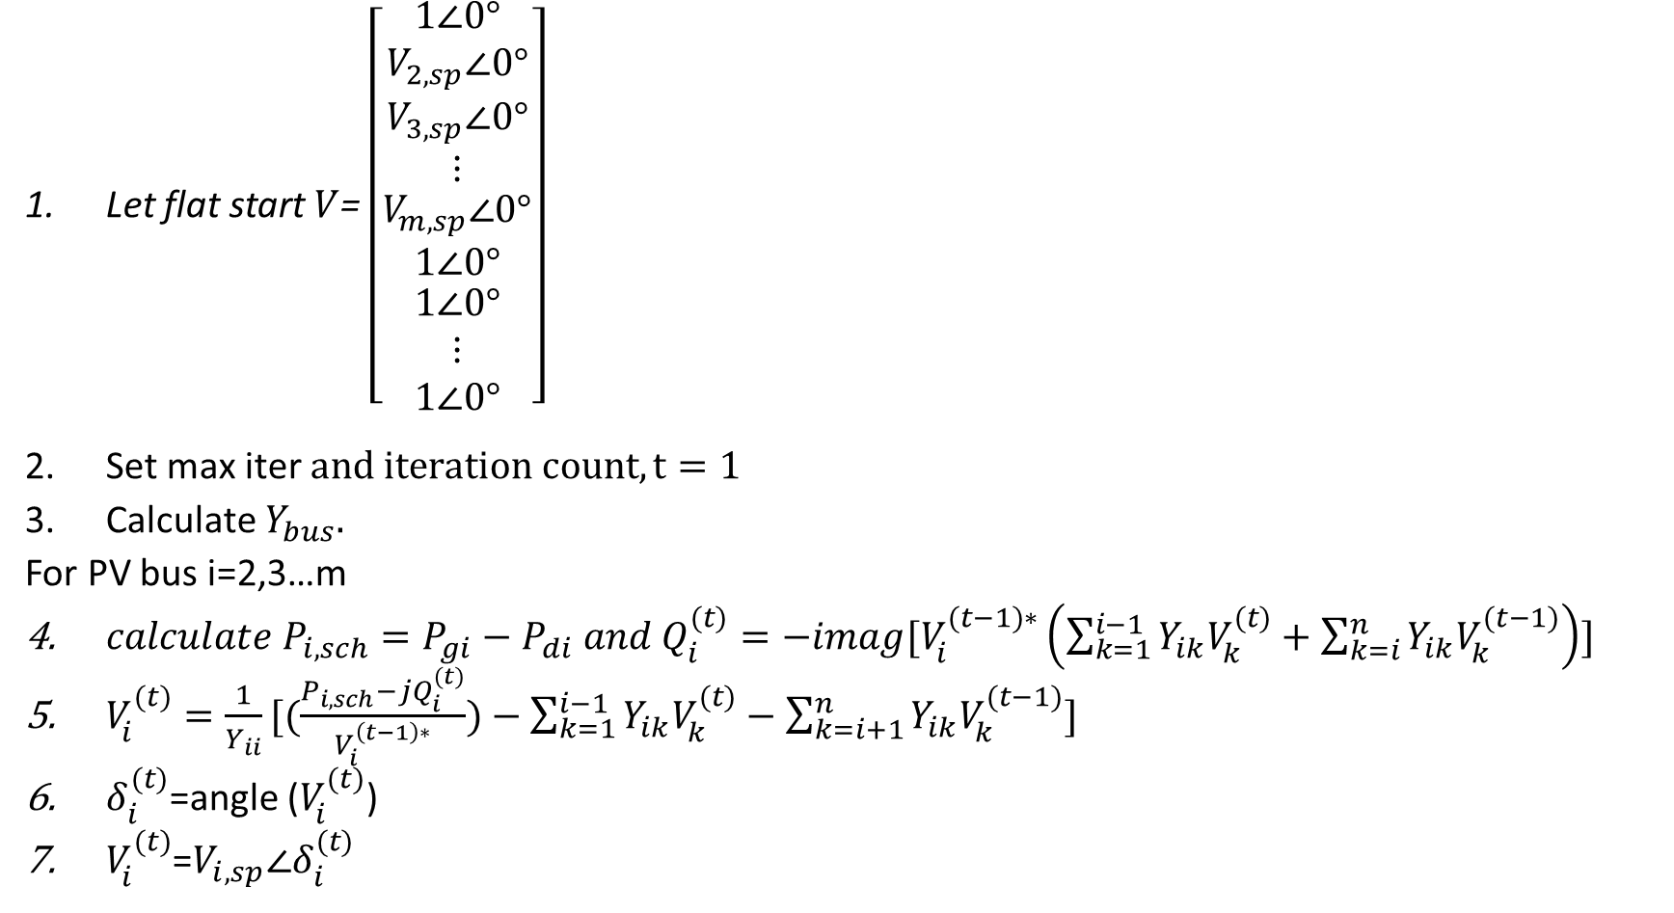
Algorithms for Gauss Seidel method (without Q limit)
Let flat start $V$= $\left[\begin{matrix}1∠0° \\ V_{2,sp}∠0° \\ \begin{matrix}V_{3,sp}∠0° \\ ⋮ \\ \begin{matrix}V_{m,sp}∠0° \\ 1∠0° \\ \begin{matrix}1∠0° \\ ⋮ \\ 1∠0°\end{matrix}\end{matrix}\end{matrix}\end{matrix}\right]$
Set max iter $and iteration count, t=1$
Calculate $Y_{bus}.$
For PV bus i=2,3…m
${calculate P}_{i,sch}=P_{gi}−P_{di} and Q_{i}^{(t)}=−imag[V_{i}^{(t−1)∗}\left(\sum_{k=1}^{i−1}{Y_{ik}V_{k}^{(t)}}+\sum_{k=i}^{n}{Y_{ik}V_{k}^{(t−1)}}\right)]$
$V_{i}^{(t)}=\frac{1}{Y_{ii}}[(\frac{P_{i,sch}−jQ_{i}^{(t)}}{V_{i}^{\left(t−1\right)∗}})−\sum_{k=1}^{i−1}{Y_{ik}V_{k}^{(t)}}−\sum_{k=i+1}^{n}{Y_{ik}V_{k}^{(t−1)}]}$
$δ_{i}^{(t)}$=angle ($V_{i}^{(t)}$)
$V_{i}^{(t)}$=$V_{i,sp}∠δ_{i}^{(t)}$

Slide 17
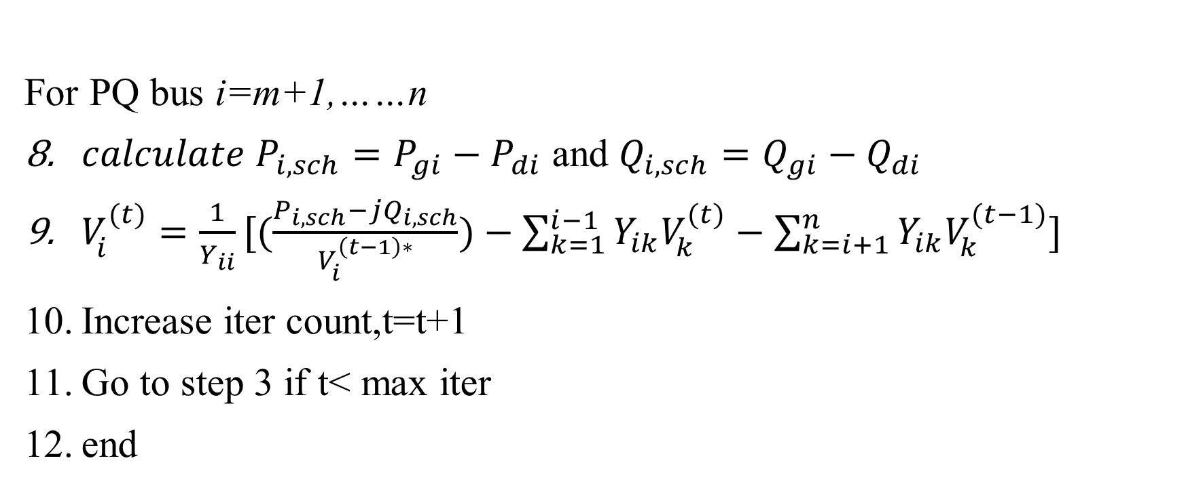
For PQ bus i=m+1,……n
${calculate P}_{i,sch}=P_{gi}−P_{di}$ and $Q_{i,sch}=Q_{gi}−Q_{di}$
$V_{i}^{(t)}=\frac{1}{Y_{ii}}[(\frac{P_{i,sch}−jQ_{i,sch}}{V_{i}^{\left(t−1\right)∗}})−\sum_{k=1}^{i−1}{Y_{ik}V_{k}^{(t)}}−\sum_{k=i+1}^{n}{Y_{ik}V_{k}^{(t−1)}]}$
Increase iter count,t=t+1
Go to step 3 if t< max iter
end

Slide 18
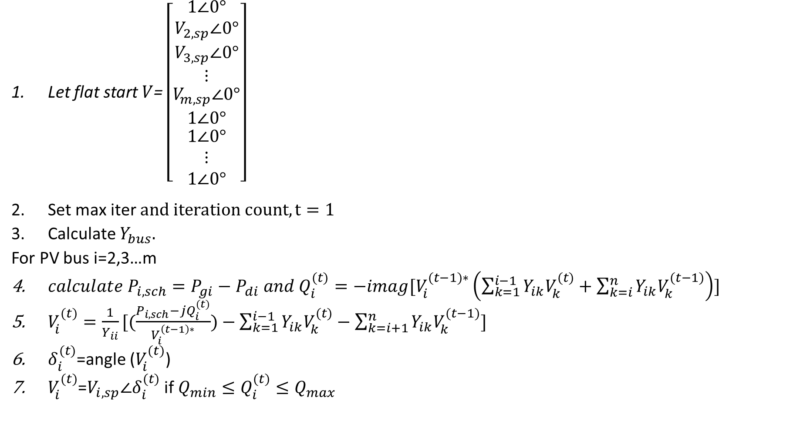
Algorithms for GS method(with Q limit)
Let flat start $V$= $\left[\begin{matrix}1∠0° \\ V_{2,sp}∠0° \\ \begin{matrix}V_{3,sp}∠0° \\ ⋮ \\ \begin{matrix}V_{m,sp}∠0° \\ 1∠0° \\ \begin{matrix}1∠0° \\ ⋮ \\ 1∠0°\end{matrix}\end{matrix}\end{matrix}\end{matrix}\right]$
Set max iter $and iteration count, t=1$
Calculate $Y_{bus}.$
For PV bus i=2,3…m
${calculate P}_{i,sch}=P_{gi}−P_{di} and Q_{i}^{(t)}=−imag[V_{i}^{(t−1)∗}\left(\sum_{k=1}^{i−1}{Y_{ik}V_{k}^{(t)}}+\sum_{k=i}^{n}{Y_{ik}V_{k}^{(t−1)}}\right)]$
$V_{i}^{(t)}=\frac{1}{Y_{ii}}[(\frac{P_{i,sch}−jQ_{i}^{(t)}}{V_{i}^{\left(t−1\right)∗}})−\sum_{k=1}^{i−1}{Y_{ik}V_{k}^{(t)}}−\sum_{k=i+1}^{n}{Y_{ik}V_{k}^{(t−1)}]}$
$δ_{i}^{(t)}$=angle ($V_{i}^{(t)}$)
$V_{i}^{(t)}$=$V_{i,sp}∠δ_{i}^{(t)}$ if $Q_{min}≤Q_{i}^{(t)}≤Q_{max}$

Slide 19
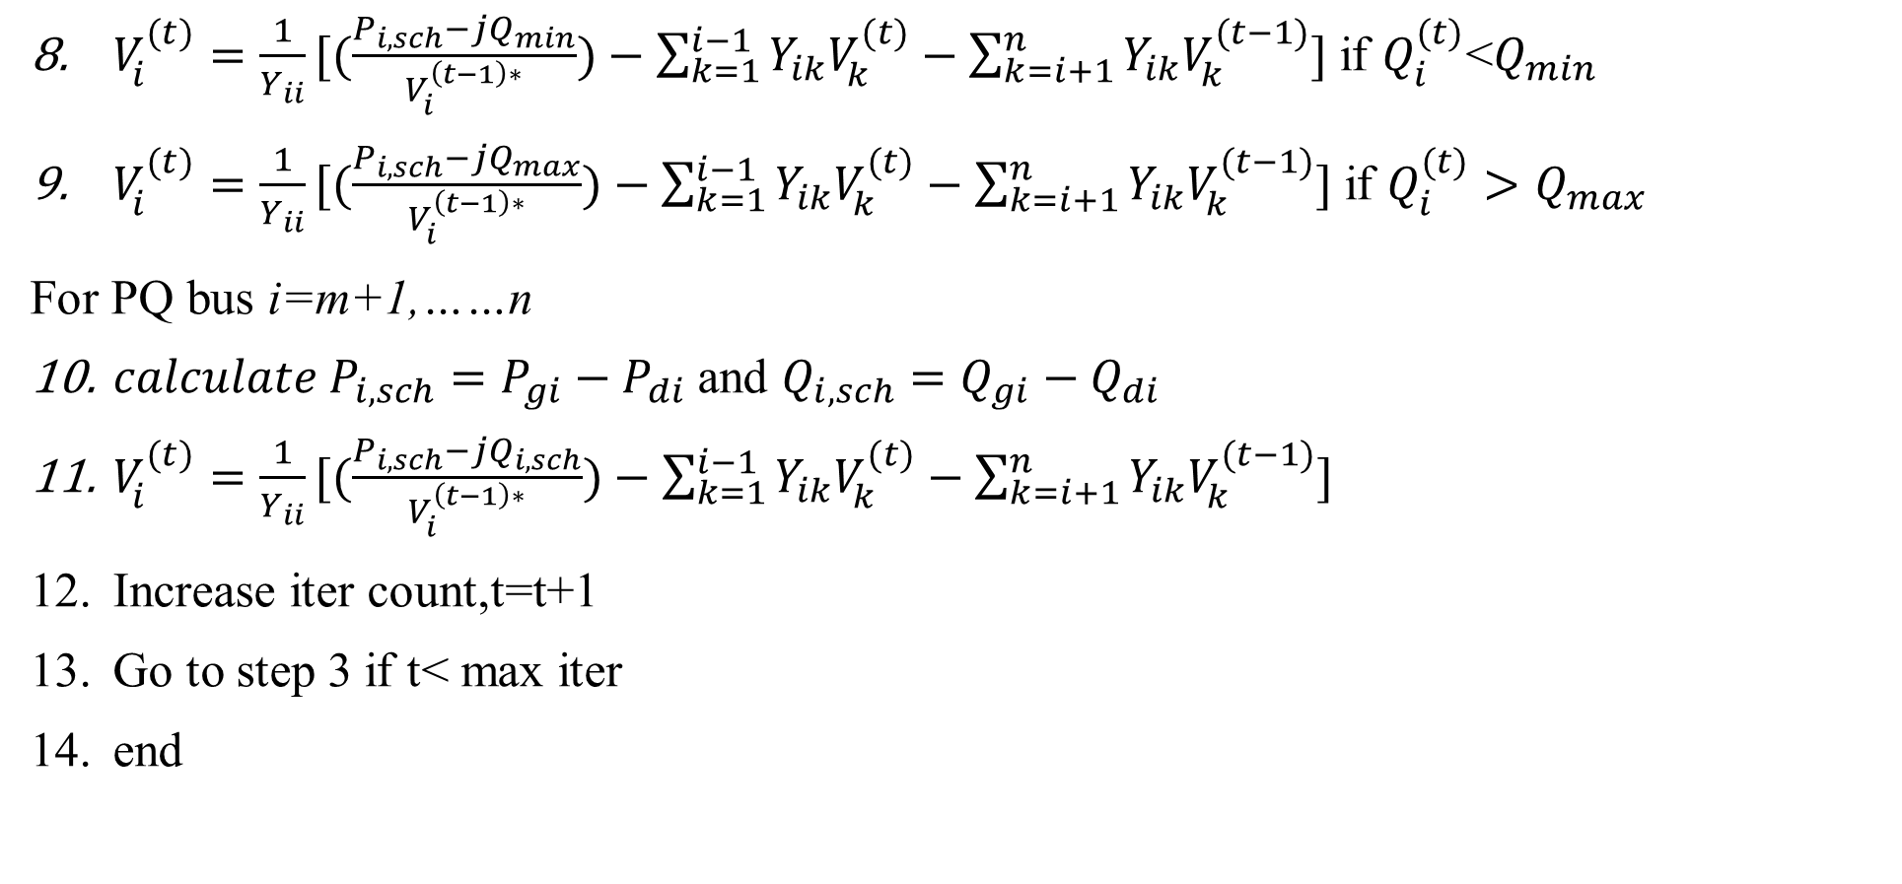
$V_{i}^{(t)}=\frac{1}{Y_{ii}}[(\frac{P_{i,sch}−jQ_{min}}{V_{i}^{\left(t−1\right)∗}})−\sum_{k=1}^{i−1}{Y_{ik}V_{k}^{(t)}}−\sum_{k=i+1}^{n}{Y_{ik}V_{k}^{(t−1)}]}$ if $Q_{i}^{(t)}$<$Q_{min}$
$V_{i}^{(t)}=\frac{1}{Y_{ii}}[(\frac{P_{i,sch}−jQ_{max}}{V_{i}^{\left(t−1\right)∗}})−\sum_{k=1}^{i−1}{Y_{ik}V_{k}^{(t)}}−\sum_{k=i+1}^{n}{Y_{ik}V_{k}^{(t−1)}]}$ if $Q_{i}^{(t)}>Q_{max}$
For PQ bus i=m+1,……n
${calculate P}_{i,sch}=P_{gi}−P_{di}$ and $Q_{i,sch}=Q_{gi}−Q_{di}$
$V_{i}^{(t)}=\frac{1}{Y_{ii}}[(\frac{P_{i,sch}−jQ_{i,sch}}{V_{i}^{\left(t−1\right)∗}})−\sum_{k=1}^{i−1}{Y_{ik}V_{k}^{(t)}}−\sum_{k=i+1}^{n}{Y_{ik}V_{k}^{(t−1)}]}$
Increase iter count,t=t+1
Go to step 3 if t< max iter
end

Slide 21
Thank You

